Slide 1
Understanding Erasmus+
International Credit Mobility
Blerinë Zjaça
Kosovo Erasmus+ Office

Slide 2
Short-term higher education mobility
For students and PhD candidates (3-12 months) & staff (5-60 days)
All levels: BA, MA, PhD, academic & administrative staff
Generous grant… and no tuition fees!

Slide 3
How does ICM work?

Slide 4
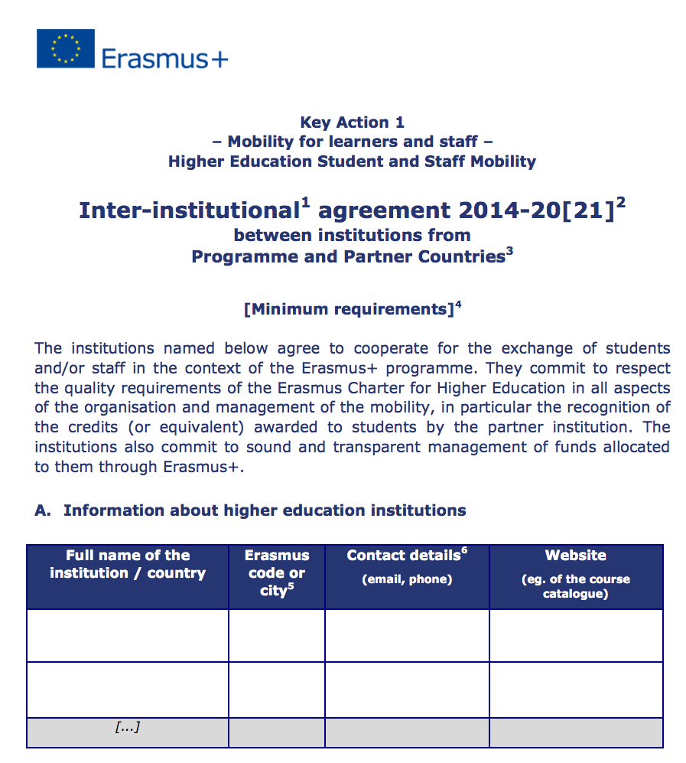
Programme Country HEI
Partner Country HEI
Notes:
By signing an inter-institutional agreement, the institutions commit themselves to respecting the principles and quality requirements of the Erasmus Charter for Higher Education (ECHE) relating to the organisation and management of mobility, and agree on a series of measures to ensure high quality mobility.
The sending institution is responsible for selecting participants and providing them with all necessary support including pre-departure preparation, monitoring during mobility, and formally recognising the mobility period. The receiving institution offers participants a study programme, or a programme of staff training or teaching activities at their institution. The inter-institutional agreement details the obligations of each institution.

Slide 5
Individual support
EUR 650-850/month for students and EUR 100-160/day for staff
Contribution to travel costs
EUR 180-1100, depending on distance travelled
Notes:
Prog HEI will receive the entire OS grant, which you can agree to share between partners in the IIA. We strongly encourage including it in the IIA.

Slide 6
THANK YOU FOR YOUR ATTENTION!

